Slide 1
Week 13 Lecture No. 25
Visual Programming C# & .Net Framework
Course Instructor: Dr. Malik Daler Ali Awan
01/10

Slide 2
Topic
Updating Data
02/10

Slide 3
Update Data Using Form
How to Update Data from Table using Window Form?
After creating , inserting, and deleting data, now its time to update the inserted record.
Steps
Use DataGridView Control to Display updated Data
Write the code (query )behind the Update Button
03/10

Slide 4
Code to Update the Record
conn.Open();
cmd = new SqlCommand("UPDATE signup SET name = @Name, email = @Email WHERE Id = @Id", conn);
cmd.Parameters.AddWithValue("@Name", txtBoxName.Text);
cmd.Parameters.AddWithValue("@Email", txtBoxEmail.Text);
cmd.Parameters.AddWithValue("@Id", txtBoxID.Text);
cmd.ExecuteNonQuery();
MessageBox.Show("Record is updated Successfully");
conn.Close();
05/10

Slide 5
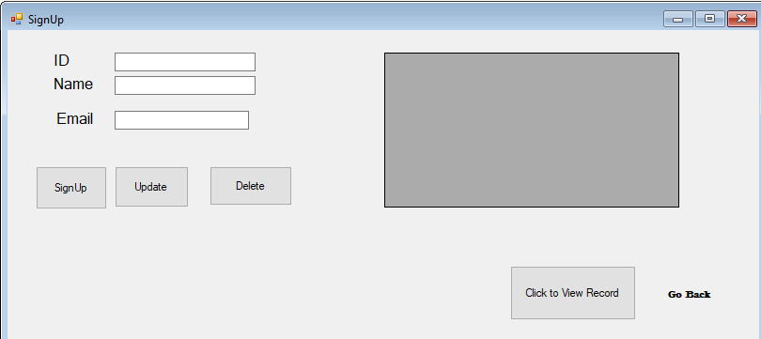
DataGridView
04/10

Slide 6
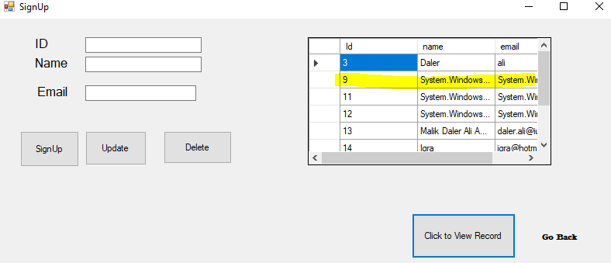
Choosing Record
06/10

Slide 7
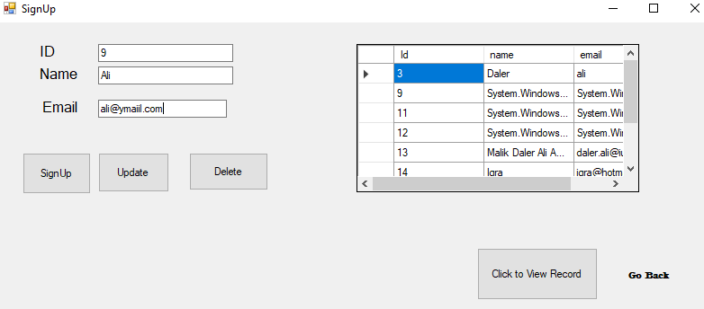
Delete Data From a Table
Enter ID (9) in this case
Add new value to Name and Email
Note: Click on Update.
07/10

Slide 8
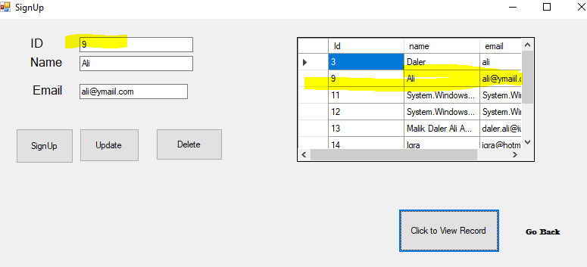
Result
After Clicking Update.
Click on View Record.
Finally Record is updated.
08/10

Slide 9
Class Activities
Implement Checks/Integration
Clear the content after performing specific action.
Hide ( ) and direct to the Relevant Forms.
09/10

Slide 10
Thank you!
10/10

